Slide 1
Transformer-based 3D Single Object Tracker
Akshay Kumar Sureddy
Roshini Pulishetty

Slide 2

Goal: Transformers as Feature Fusion Networks
Siamese Backbone
Feature Fusion
Region Proposal Network
Transformer based 3D Object Tracker
Search Point cloud sequence
Template Point cloud
Notes:
Explain about goal, sot architecture in brief, permutation invariant feature augmentors and transformers

Slide 3
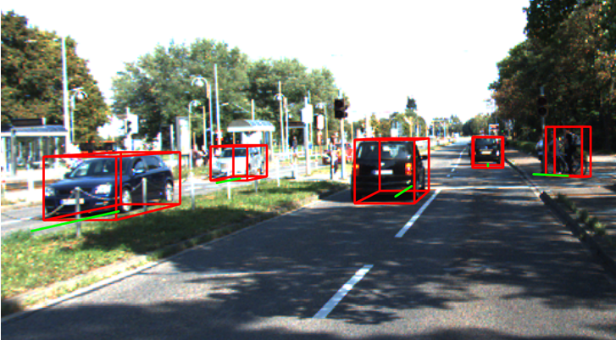

Motivation: 3D Object Tracking for Self-Driving Cars
Robust methods for Real-time Object Localization
Limited depth information in 2D
Realtime 3D Object Detection for Automated Driving Using Stereo Vision and Semantic Information
Limited Depth Information
Illumination Issues

Slide 4
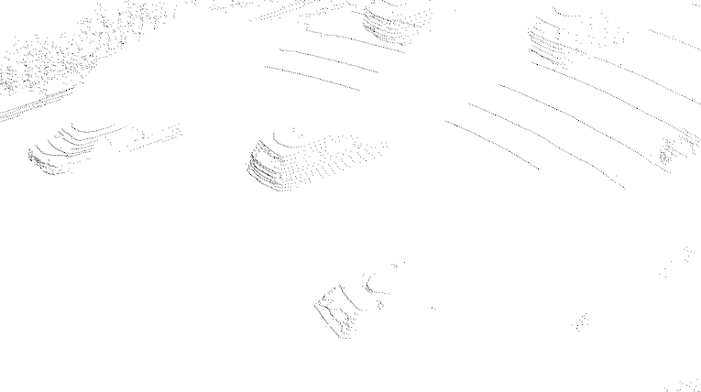
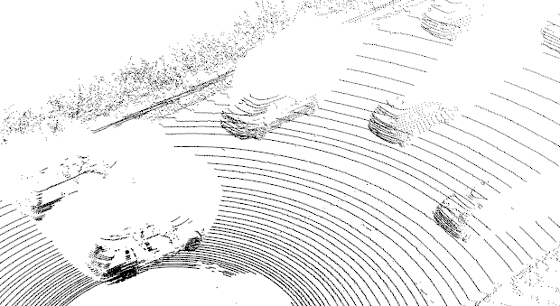
Key Challenges:
Point Cloud sparsity
Non-Rigid Objects
Permutation Invariance
Real-time tracking
Occlusions in Point Clouds

Slide 5
Related Work:
SC3D
pioneer work using Siamese paradigm for object tracking for the first time.
Deterministic
P2B
Point to Box relation within Siamese architecture.
End-to-end trainable
OSP2B
Efficient network for parallelizing voting the regions and determining target-ness scores.

Slide 6
Pipeline
P2B RPN
Template Seeds
Normalize
T
512x3
PointNet++
Multihead Cross-Attn
Fused Seeds
3D BBox
Search Seeds
Normalize
S
1024x3
PointNet++
Multihead Self-Attn
Q K V

Slide 7
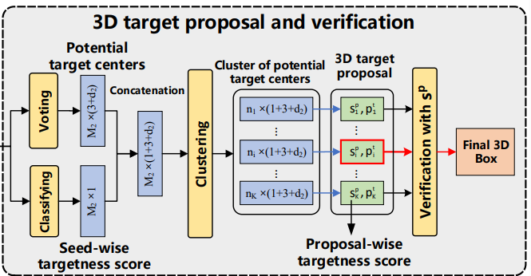
Pipeline - RPN (P2B)
Ref: P2B

Slide 8
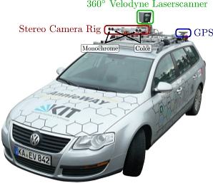
Dataset
KITTI Dataset
Velodyne - 21 Training Sequences
0-16 used for training
17-18 for validation
19-20 for testing
https://www.cvlibs.net/datasets/kitti/index.php

Slide 9
Results
Model | Precision/Success
 | Car | Pedestrian | Van | Cyclist | Mean
P2B | 72.8 / 56.2 | 49.6 / 28.7 | 48.4 / 40.8 | 44.7 / 32.1 | 60.0 / 42.4
OSP2B | 82.3 / 67.5 | 85.1 / 53.6 | 66.2 / 56.3 | 90.5 / 65.6 | 82.3 / 60.5
LTTR | 77.1 / 65.0 | 56.8 / 33.2 | 48.4 / 35.8 | 89.9 / 66.2 | 65.8 / 48.7
Ours | 72.0 / 56.8 | 63.9 / 35.7 | 52.8 / 45.6 | 46.5 / 34.1 | 66.0 / 45.5
Success: Area Under the curve (AUC) determined by comparing the bounding box overlap threshold with the percentage of correctly tracked frames.
Precision: Percentage of frames where the tracked object’s centers of the are within 2 meter from the groundtruth

Slide 10
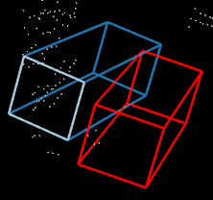
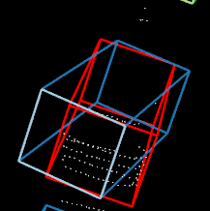
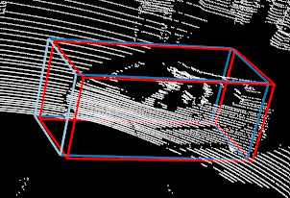
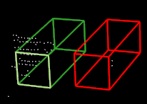
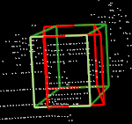
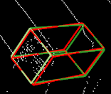
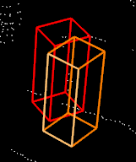
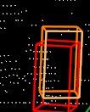
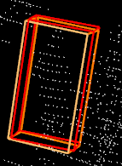
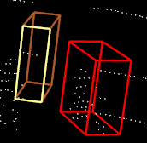
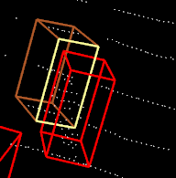
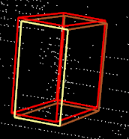
Shortcomings
Car
Van
Ped
Cyc
Sparse Point Clouds
Occluded Point Clouds
Sparse Occluded Good

Slide 11
Sample Predictions

Slide 12
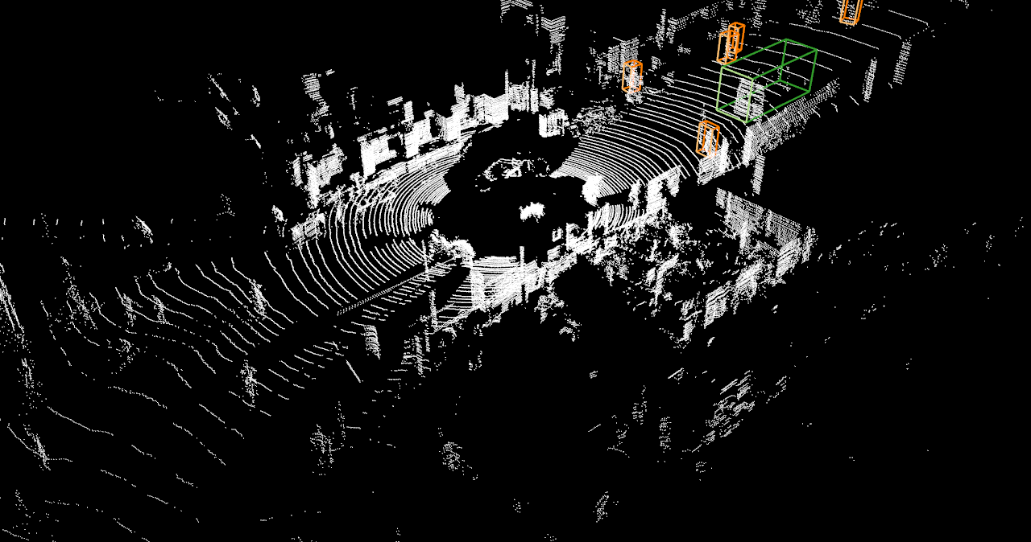
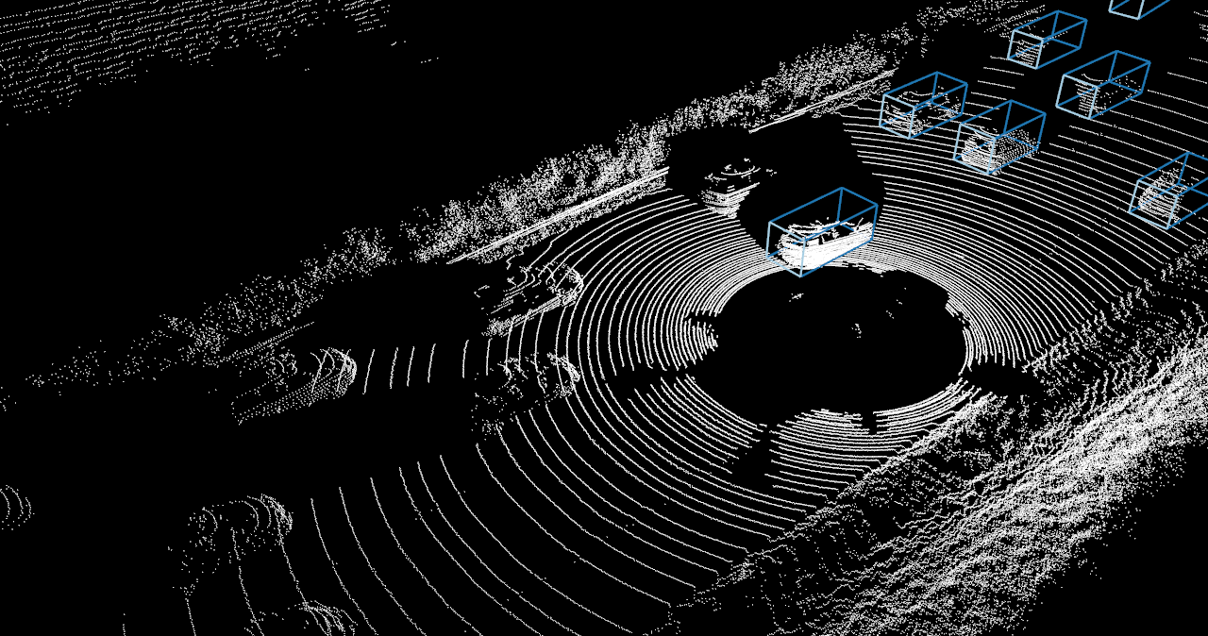
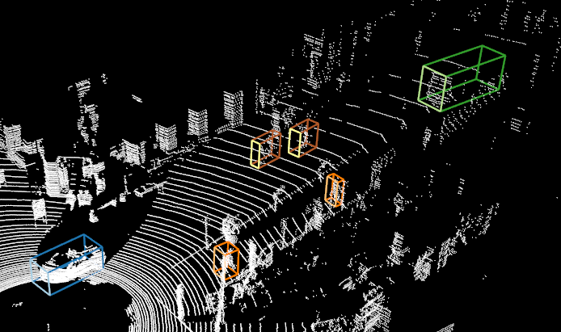
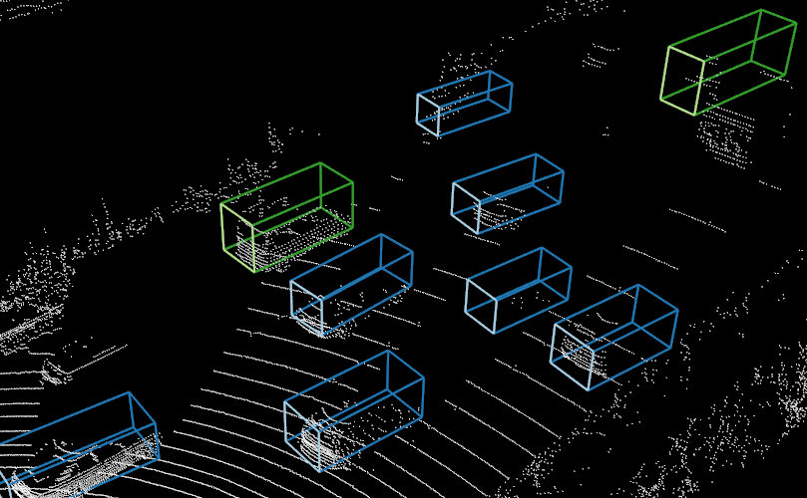
Sample Predictions

Slide 13
Future Improvements
Point Cloud Completion for Occlusions and Sparse Point Clouds
Using Image information (2D and 3D)

